Slide 1
Course - DT228/1 and DT282/1
Subject - Computer Architecture and Technology
INTERNAL AND EXTERNAL INTERFACES
Semester 2, Week 9

Slide 2
Bus Development
In computer architecture, a bus is a subsystem that transfers data or power between computer components inside a computer or between computers and typically is controlled by device driver software.
Unlike a point-to-point connection, a bus can logically connect several peripherals over the same set of wires.
Each bus defines its set of connectors to physically plug devices, cards or cables together.

Slide 3
Bus Development (2)
Early computer buses were literally parallel electrical ‘bus’ wires with multiple connections, but the term is now used for any physical arrangement that provides the same logical functionality as a parallel electrical bus.
Modern computer buses can use both parallel and bit-serial connections, and can be wired in either a multidrop (electrical parallel) or daisy chain topology, or connected by switched hubs, as in the case of USB (Universal Serial Bus).

Slide 4
Bus Development (3)
The developments in buses from the early computers (1950s) – since the technicians ‘hijacked’ the memory bus to connect non-memory devices to get the CPU to take their data – has occurred, mainly, to allow interrupts.
The speed of the CPU compared to internal and external devices caused other refinements – such as ‘northbridge’ and ‘southbridge’.

Slide 5
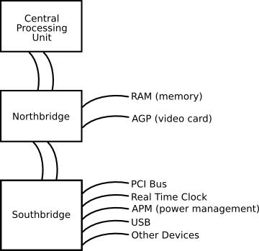
“The Bridges of CPU County”
This is a general view of devices that may be linked, possibly, to the bridges. (More on the northbridge and southbridge later.)

Slide 6
Bus History (4)
These developing systems shared architecture qualities with their earlier computers that meant that every device on the bus had to communicate at the same speed.
An isolated CPU could increase in speed. CPUs and memory continued to increase in speed much faster than the buses they communicated with.

Slide 7
Parallel and Serial
At one time "bus" meant an electrically parallel system, with electrical conductors similar or identical to the pins on the CPU. But in modern systems, buses’ and networks’ architecture have become similar in appearance.
Buses can be parallel buses, which carry data words striped across multiple wires, or serial buses, which carry data in bit-serial form. The addition of extra power and control connections, differential drivers and data connections in each direction usually means that most serial buses have more conductors than the minimum of two used in the I²C (Inter-Integrated Circuit) serial bus.

Slide 8
Parallel and Serial (2)
As data rates increase, the problems of timing skew and crosstalk across parallel buses become more and more difficult to work around.
One partial solution to this problem has been to double pump the bus.
(Crosstalk is the effect of bus wires carrying current (data) being so close together that one absorbs the other’s current – so a 0 might pick up some of the current of a 1 next to it and show 1 and 1 instead of 0 and 1.)

Slide 9
Parallel and Serial (3)
Often, a serial bus can actually be operated at higher overall data rates than a parallel bus, despite having fewer electrical connections, because a serial bus inherently has no timing skew or crosstalk. USB, FireWire, and Serial ATA are examples of this.
Multidrop connections do not work well for fast serial buses, so most modern serial buses use daisy-chain or hub designs.

Slide 10
Parallel and Serial (4)
Most computers have both internal and external buses. An internal bus connects all the internal components of a computer to the motherboard (and thus, the CPU and internal memory). These types of buses are also referred to as a local bus because they are intended to connect to local devices, not to those in other machines or external to the computer. An external bus connects external peripheral devices to the motherboard.

Slide 11
Examples of Internal Bus Interfaces
Parallel
Industry Standard Architecture (ISA)
Extended ISA (EISA)
Low Pin Count (LPC)
MicroChannel (MCA)
MBus
Multibus (for industrial systems)
NuBus ( = IEEE 1196)
Peripheral Component Interconnect (PCI)
SBus (= IEEE 1496)
VESA Local Bus (VLB or VL-bus)

Slide 12
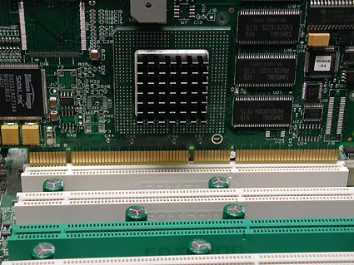
Peripheral Component Interconnect

Slide 13
Examples of Internal Bus Interfaces (2)
Serial
1-Wire
HyperTransport
I²C
PCI Express (PCIe)
Serial Peripheral Interface Bus (SPI bus)
USB (Universal Serial Bus)
FireWire ( = i.Link or IEEE 1394)

Slide 14
Examples of External Bus Interfaces
Advanced Technology Attachment (ATA – similar to PATA, IDE, EIDE, ATAPI, etc.) A disk/tape peripheral attachment bus. (The original ATA is parallel)
HIPPI (HIgh Performance Parallel Interface)
IEEE-488 ( = GPIB, General-Purpose Instrumentation Bus, and HPIB, Hewlett-Packard Instrumentation Bus)
PCMCIA (later called ‘PC card’, then ‘ExpressCard’, but fading with the introduction of USB and built-in network and modem connections.
SCSI (Sounds like ‘scuzzy’ - Small Computer System Interface) A disk/tape and peripheral attachment bus.

Slide 15
Examples of Internal and External Bus Interfaces
Futurebus
InfiniBand
QuickRing
SCI - Scalable Coherent Interface
Many interface types become superceded or develop into other interface architectures (as PCMCIA became ‘ExpressCard’ and IDE became ATA)

Slide 16
Expanding on Some Examples
There follows a listing of some of the internal and external interface types with comments added.
They have been selected, not for their high-performance, but because of their common appearance among ‘real world’ technical specification documents.

Slide 17
Internal interface standards
AGP (Accelerated Graphics Port)
(For a graphics card / motherboard) Accelerated Graphics Port, an interface that was made obsolete by PCIe. 4x = 1 GB/sec; 8x = 2 GB/sec.
ATA (Advanced Technology Attachment)
AT - An obsolete form factor, was not compatible with ATX. The old IBM architecture that is ancestor to all modern PCs. (PC begat XT, and XT begat AT, and AT begat most others.) The ‘A’ at the end is for ‘Attachment’.

Slide 18
IDE
IDE Bus IDE, or Integrated Drive Electronics, was the most common low-cost interface for connecting hard disks, CD-ROMs, DVD-ROMs and other storage-oriented devices to the desktop PC. The official specification for the IDE interface is ATA (AT Attachment). This specification comes in several ‘flavours’, which relate to the maximum data transfer speed if both the chipset and drive support the standard. The number following the ATA letters on a drive or chipset specification let the consumer know the maximum transfer speed supported.

Slide 19
ATA
ATA type and speed examples;
ATA/33 - 33.3 MB/sec
ATA/66 - 66.6 MB/sec
ATA/100 - 100.0 MB/sec
ATA/133 - 133.0 MB/sec
…and a modern one:
ATA/167 - 167 MB/sec

Slide 20
More on ATA
The newer and faster ATA specifications have increased data rate by reducing interference and crosstalk. To accomplish this an 80-conductor drive cable was introduced when ATA/66 emerged.
To further increase data transfer speeds, the ATA/100 added specifications for measuring and limiting crosstalk on the printed circuit board. Faster IDE transfer speeds meant that chipset designers chose to make changes to the southbridge's communication to the northbridge.

Slide 21
SATA
SATA
(For the hard drive) Serial ATA, competitor for PATA with smaller cables. Currently, there is no impact on I/O performance vs ATA. However, SATA has the advantage of avoiding the IDE (Integrated Drive Electronics) master/slave cable-sharing arrangement and freeing up IDE slots for other devices.
SATA 150 - First generation SATA, 1.5 GHz yielding transfer rate of 150 MB/s.
SATA 300 - Second generation SATA, 3.0 GHz yielding transfer rate of 300 MB/s.
SATA 6.0 - Third generation SATA, 6.0 GHz yielding transfer rate of 600 MB/s.

Slide 22
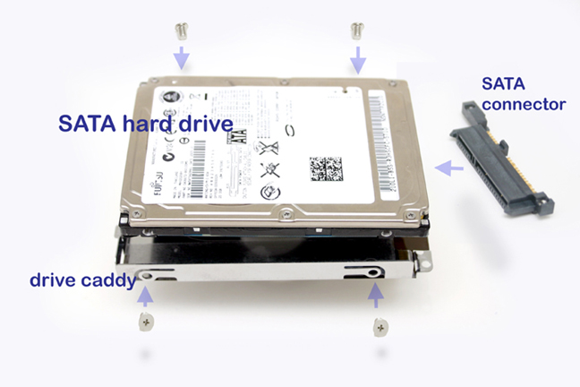
SATA (2)

Slide 23
PATA
PATA
(For hard drive) Parallel ATA, the underlying spec of IDE / EIDE, is notable for clunky, wide ribbon cables and master/slave cable sharing.
During 2006 and 2007, PATA became obsolete because of SATA. The one thing that kept it going is the unavailability of SATA optical drives.
The maximum rate is (was) about 133 MHz.

Slide 24
PCI
PCI
(Peripheral Component Interconnect) 64-bit parallel bus, comes in 33 MHz and 66 MHz types.
PCIe
(For the graphics card / motherboard) PCI-Express, an interface that succeeded in taking over AGP 8x even though there was no performance benefit in doing so. PCIe x16 (16 slot) = 4 GB/sec, up to 8Gig Transfers/Sec.

Slide 25
PCI (2)
PCI
PCI has historically held an important role in chipset interconnect architecture. Until recently it has been responsible for connecting the north and south bridges, allowing up to 133MB/s (theoretical) transfer rates.
When using faster drives, network adapters, and so on, the PCI bus became an inadequate interconnect bus. Intel and VIA have newer chipsets utilising proprietary point-to-point connections to increase interconnect bandwidth to 266MB/s.
AMD's HyperTransport allows data transfer between the two bridges up to 1.6GB/s. These new interconnect methods relegate the PCI bus to just being another component connected to the southbridge.

Slide 26
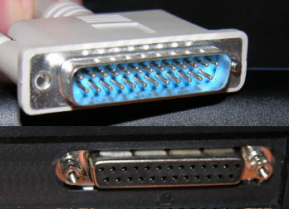
External Interfaces
External interface types
Parallel port A type of interface that allows more than one bit of data to be processed at once. Printers are (were) the most common peripheral devices connected to parallel ports.

Slide 27
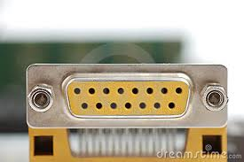
External Interfaces (2)
Serial port
A type of interface in which only 1 bit of data is transferred at a time. Mice and modems are used to be connected to serial ports, which were also referred to as COM ports.
The projector here is
connected with a 15-pin
serial.

Slide 28
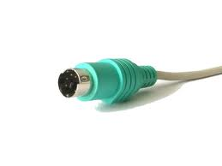
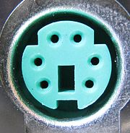
External Interfaces (3)
PS/2 Another type of port (or interface) that can be used to connect mice and keyboards to the computer. The PS/2 port is sometimes called the mouse port.

Slide 29
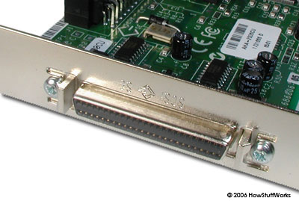
External Interfaces (4)
SCSI Bus
(Small Computer Systems Interface) – SCSI - is used as a 8 or 16-bit parallel interface used to attach peripheral devices to the PC. The latest version runs at 320MB/Sec. SCSI was always much more expensive then IDE buses; however parallel SCSI is being replaced by Serial SCSI.

Slide 30
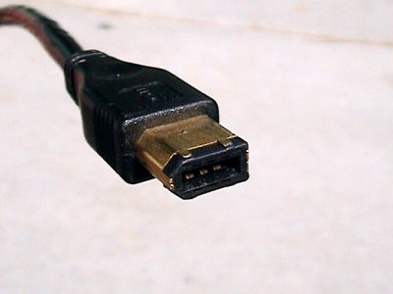
Firewire
FireWire Bus
(The IEEE 1394), was (is) used as a high-speed serial bus between a PC and peripheral device.
iLink
This is Sony's name for FireWire, iLink is based on IEEE-1394 using conventional metallic conductors.

Slide 31
USB
USB Bus
The Universal Serial Bus provides two-way communication between the PC and peripheral devices, over a differential serial interface cable. A slow-speed mode of 1.5Mbps is used for devices such as the mouse. Full-speed mode is used by most devices and allows a transfer rate of 12Mbps. High-speed mode (defined by USB 2.0) allows rates of 480Mbps.

Slide 32
USB (2)
Not too long ago, system designers realised that users needed an easier way to install peripherals and that many peripheral devices would benefit from a faster system interface speed.
The old serial port was looking inefficient and, with the advent of devices like digital cameras and web cams, transferring data via the serial port was painfully slow.
Thus a new serial bus, USB, was introduced. USB 1.1 has a maximum bandwidth of up to 12 Mbits/sec, giving higher speed devices a much larger pipeline to utilise.

Slide 33
USB (3)
USB devices come in two distinct types. Low speed devices transfer data using a 1.5 Mbit/s, while fast devices utilise the entire 12 MB/s bandwidth.
The PC supplies 500 milliamps of power through each individual USB port, meaning that many low power devices can run without a built-in power supply.
This can reduce both cost and increase ease of use.

Slide 34
USB (4)
While USB 1.x was initially designed to replace legacy serial and parallel connections, the USB 2.0 is different and was designed to compete with IEEE 1394 ("Firewire").
It increases the available bandwidth to 480Mbits/sec, allowing devices such as video conferencing cameras, networking connections, and external storage devices to have the bandwidth they need. Most modern southbridge chips have one or two integrated USB controllers that can handle up to two motherboard connections each. Some of the newest support up to six USB ports.

Slide 35
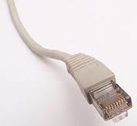
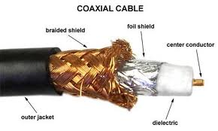
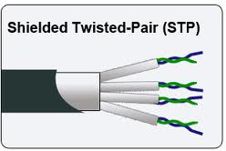
Ethernet Bus
Ethernet Bus
The Ethernet Bus Standard is used as a Local Area Network (LAN). The normal implementation is over a coax or twisted pair cable at either 10Mbps or 100Mbps.
Ethernet connector RJ-45
Coaxial cable

Slide 36
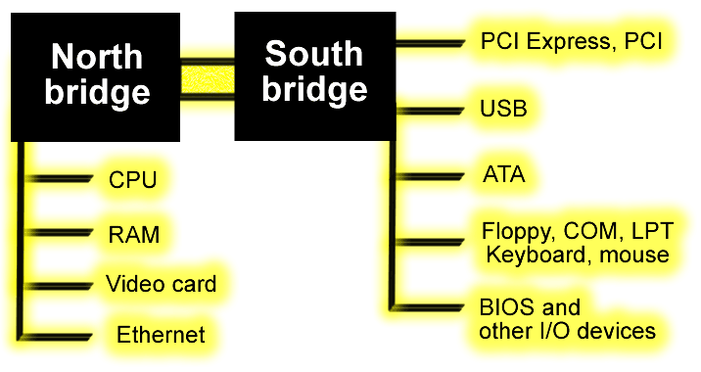
Another Northbridge Southbridge Diagram
The northbridge connects to higher-speed devices than the southbridge.
PCI express may be connected to northbridge or southbridge.
Graphics fans will prefer northbridge

Slide 37
Northbridge, Southbridge
The northbridge, also known as the Memory Controller Hub (MCH), is traditionally one of the two chips in the core logic chipset on a PC motherboard, the other being the southbridge. Separating the chipset into northbridge and southbridge is common, although there are rare instances where these two chips have been combined onto one die when design complexity and fabrication processes permit it.

Slide 38
Northbridge
The northbridge typically handles communications between the CPU, RAM, AGP or PCI Express, and the southbridge. Some northbridges also contain integrated video controllers, which are also known as a Graphics and Memory Controller Hub (GMCH). Because different processors and RAM require different signalling, a northbridge will typically work with only one or two classes of CPUs and generally only one type of RAM.

Slide 39
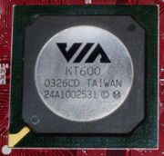
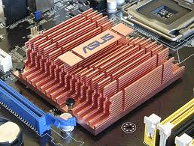
Northbridge
The name is derived from drawing the architecture in the fashion of a map. The CPU would be at the top of the map at due north. The CPU would be connected to the chipset via a fast bridge (the northbridge) located north of other system devices as drawn. The northbridge would then be connected to the rest of the chipset via a slow bridge (the southbridge) located south of other system devices as drawn.
A VIA northbridge chip
A northbridge chip with heatsink

Slide 40
Northbridge (2)
The northbridge on a particular system's motherboard is the most prominent factor in dictating the number, speed, and type of CPU(s) and the amount, speed, and type of RAM that can be used. Other factors such as voltage regulation and available number of connectors also play a role. Virtually all consumer-level chipsets support only one processor, with the maximum amount of RAM varying by processor type and motherboard design.

Slide 41
Northbridge (3)
Pentium-era machines often had a limitation of 128 MB, while Pentium 4 machines had a limit of 4 GB. With the Pentium Pro, the Intel architecture can accommodate physical addresses larger than 32 bits, typically 36 bits, which give up to 64 GB of addressing.
A northbridge typically will only work with one or two different southbridge ASICs (Application-Specific Integrated Circuit); in this respect, it affects some of the other features that a given system can have by limiting which technologies are available on its southbridge partner.

Slide 42
Northbridge (4)
The northbridge plays an important part in how far a computer can be overclocked, as its frequency is used as a baseline for the CPU to establish its own operating frequency. In today's machines, the chip is becoming increasingly hotter as computers become faster. It is not unusual for the northbridge to now use some type of heatsink or active cooling.
(Overclocking is the process of making a computer or component operate faster than the clock frequency specified by the manufacturer by modifying system parameters.)

Slide 43
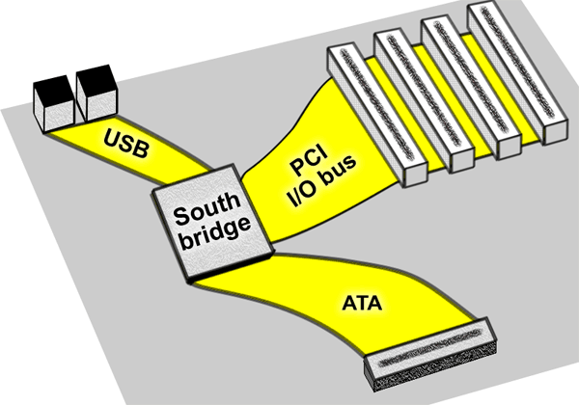
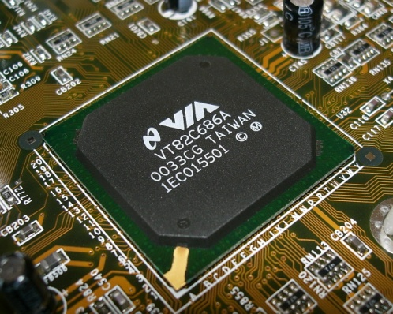
Southbridge
A VIA southbridge chip
Buses and standards managed by southbridges (including USB, IDE, PCI, Audio, LAN, and Super I/O legacy devices).

Slide 44
Southbridge (2)
Connecting the southbridge During the Pentium era chipset designers avoided bottlenecks in motherboard designs. As peripheral connections became more sophisticated it became obvious that the PCI bus could no longer be used to connect the north and southbridge chips. The PCI was not efficient enough. Improvements in device speeds of internal and external devices created larger bandwidth requirements for the connection between north and southbridges.

Slide 45
Southbridge (3)
An increased number of devices was attached to the southbridge. It is easy to see that using the PCI bus as a chipset interconnect can be a system bottleneck. Plus, it is important to note that while PCI's theoretical maximum data transfer rate is 133MB/sec, in reality, with protocol and operating system overhead, a maximum of 80-100MB/sec is more realistic, with sustained rates of 40MB-80MB/sec being most common.

Slide 46
V-Link
VIA's V-Link Intel is not the only one with a new point-to-point bridge architecture; VIA has chipsets like their Apollo KT266 utilizing their V-Link Hub Architecture technology. Extremely similar to Intel's hub architecture, even though introduced a year or so later, V-Link also operates at speeds of up to 133MHz, doubling peak bandwidth to 266MB/sec between the north and southbridge.

Slide 47
Industry Standard Architecture
ISA and Super I/O Most chipsets still support ISA bus capability, typically through a bridge chip that connects to the PCI bus. Today many new systems shun actual ISA slots. However, legacy peripherals such as serial ports, parallel ports, a game port, a PS/2 mouse/keyboard, an infrared interface, and a floppy disk controller are generally supported through a Super I/O chip that attaches to the southbridge often through a Low Pin Count (LPC) interface. An integrated 8254-compatible timer, dual 8259-compatible interrupt controllers, dual 8237-compatible DMA controllers, and real-time clock are also included in the southbridge for ISA compatibility.

Slide 48

HyperTransport
AMD's HyperTransport HyperTransport was developed by AMD and has been licensed to around 200 companies involved in processor manufacture. Formerly known as Lightning Data Transport (LDT), it was a newer technology that provided a high performance point-to-point link for interconnecting circuits on a motherboard.

Slide 49
3rd generation Bus (Interface)
"Third generation" buses such as HyperTransport and InfiniBand run at the very high speeds needed to support memory and video cards, while also supporting lower speeds when talking to slower devices such as disk drives.
They are flexible in terms of their physical connections, allowing them to be used both as internal buses, as well as connecting different machines together.

Slide 50
3rd generation Bus (Interface) (2)
This can lead to complex problems when trying to service different requests, so much of the work on these systems concerns software design, as opposed to the hardware itself. In general, these third generation buses tend to look more like a network than the original concept of a bus, with a higher protocol overhead needed than for early systems, while also allowing multiple devices to use the bus at once.

Slide 51
Hyper Transport (2)
Network connections such as Ethernet are not generally regarded as buses, although the difference is largely conceptual rather than practical. The arrival of technologies such as InfiniBand and HyperTransport is further blurring the boundaries between networks and buses.
Even the lines between internal and external are sometimes fuzzy, I²C can be used as both an internal bus, or an external bus (where it is known as ACCESS.bus), and InfiniBand is intended to replace both internal buses like PCI as well as external ones like Fibre Channel.

Slide 52
Hyper Transport (3)
Modern trends in personal computers, especially laptops, have been moving towards eliminating all external connections except for modem jack, Cat5, USB, headphone jack, and optional VGA or FireWire.

Slide 53
Next…
Next week we can start taking a look at how computers can connect to each other...
… in networks.

